Slide 1
Embedded Learning Multi-Domain Convolutional Neural Networks for Visual Tracking
CSED499I
High-level Design
20080650 CSE
Jeongbin Choe
Advisor: Prof. Bohyung Han (CV Lab)

Slide 2
Introduction
Multi-Domain Network (MDNet)
Consists of shared CNN layers and multiple branches of domain-specific layers
MATLAB based framework
The winner of The VOT2015 Challenge
Performed 1 fps with 8 cores Intel Xeon CPU + NVIDIA Tesla
Project Goal
Port MDNet to iPhone 6+ and optimize its performances
Implement MDNet based real-time learning and object tracking application

Slide 3
Requirements Summary
Embedded MDNet
Performs visual tracking on iPhone 6+ with targets used in VOT2015 challenges
Keeps at least 1 fps
YouTube
Real-time Application
Requires user to teach the neural networks with objects detected by scanning around with a camera
After training, performs real-time visual tracking through the camera

Slide 4
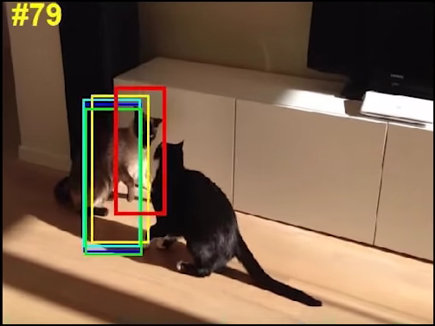
Architecture - Embedded MDNet (1)
{
“pooling_param”: {
“stride”: 1,
“kernel_size”: 8,
“pool”: 1
},
“name”: {
“top”: [
0.97 fps
JSON formatted models
train
CNN-layers
(DeepLearningKit)
track
optimize
convert
Fernando
Sequence
MDNet pretraining models
Reduce the size of input or the number of layers
Remove online tracking process

Slide 5
Architecture - Embedded MDNet (2)
// Initialize.
opts.inputSize = 107 <- To reduce
deepNetwork = DeepNetwork()
deepNetwork.loadDeepNetworkFromJSON(”mdnet_pretrained.json”)
// Learning CNN
deepNetwork = deepNetwork.finetune(deepNetwork, …)
...
// Disable online update here.
...
// Main loop
for nFrames
// Evaluate and Draw
CNN-layers
(DeepLearningKit)
Port
‘mdnet_run.m’,
‘mdnet_finetune.m’,
‘mdnet_init.m’,
…
from original project
(for MATLAB)
to iPhone (Swift)

Slide 6
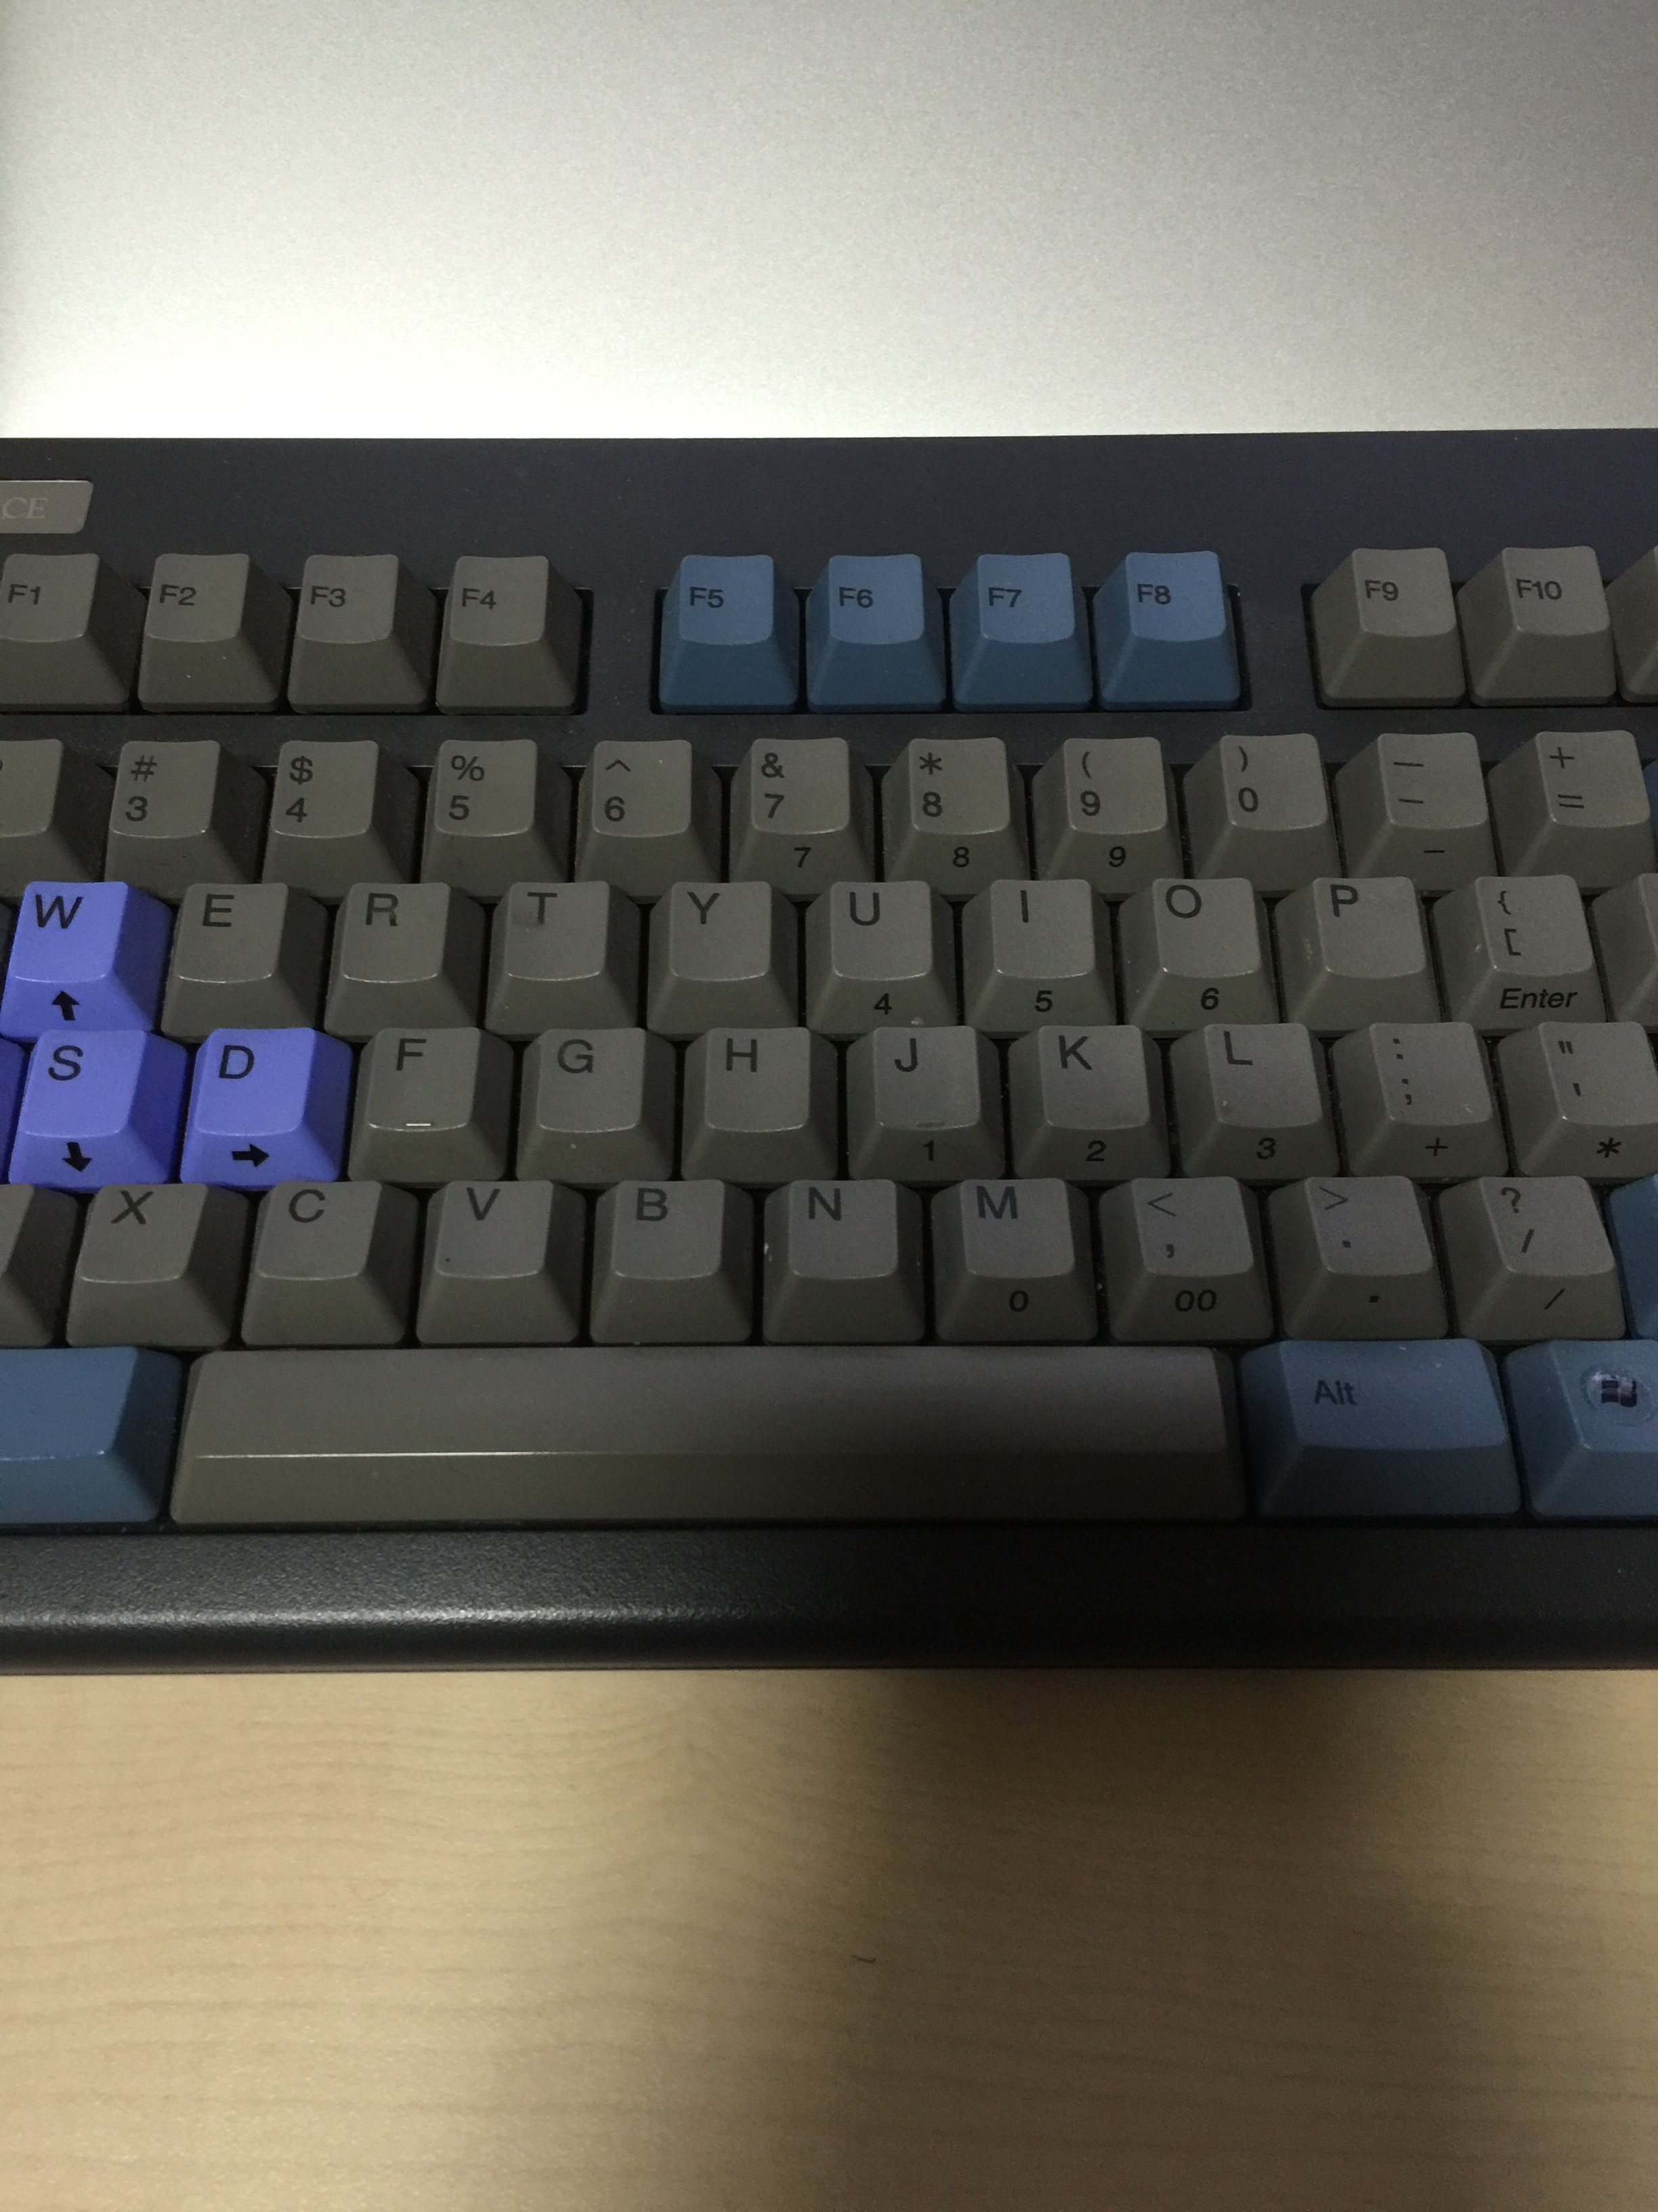
Architecture - Application (1)
Selecting…
CNN-layers
realtime track
train
Image Raw Data
User drag object
in camera

Slide 7
Architecture - Application (2)
// Open a Camera.
_videoCamera = [[CvVideoCamera alloc] initWithParentView:self.cameraView];
// Load CNN
deepNetwork = [[DeepNetwork alloc] init];
// Track and Learn
[tracker processImage:image withNetwork:(deepNetwork)];
...
// Draw bounding box
…
CNN-layers
(DeepLearningKit)
Objective-C

Slide 8
Architecture - Interface
0.97 fps
Embedded MDNet
Fernando
Sequence
Realtime Application
Tracking while moving

Slide 9
References
Hyeonseob Nam and Bohyung Han, Learning Multi-Domain Convolutional Neural Networks for Visual Tracking, arXiv, 2015.
Y. Wu, J. Lim, and M. Yang. Object tracking benchmark. TPAMI, 2015.
http://acsweb.ucsd.edu/~yuw176/report/ECE273.pdf
http://www.votchallenge.net/vot2015
http://deeplearningkit.org
https://github.com/clementfarabet/torch-ios
https://github.com/HyeonseobNam/MDNet

